Slide 1
QR Code Activation
Notes:
Hi! Welcome to Hero! I’m going to walk you through the steps of creating your student Hero account through QR Code Activation.

Slide 2
QR Code Activation – TEACHER INSTRUCTIONS
Notes:
Let’s first start with the teacher instructions.

Slide 3
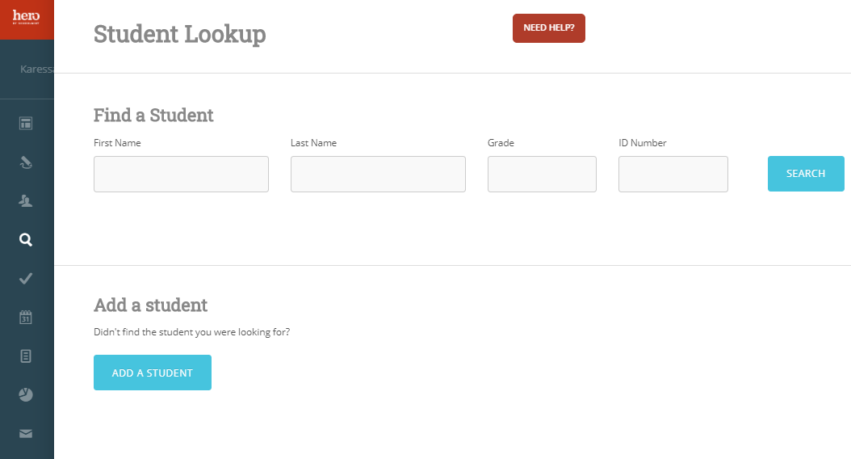
Log in to your Hero web portal at https://access.heropowered.com
Select the magnifying glass “Student Lookup” icon.
Notes:
Step 1: Log in to your Hero web portal at https://access.heropowered.com and select the magnifying glass/student lookup icon.

Slide 4
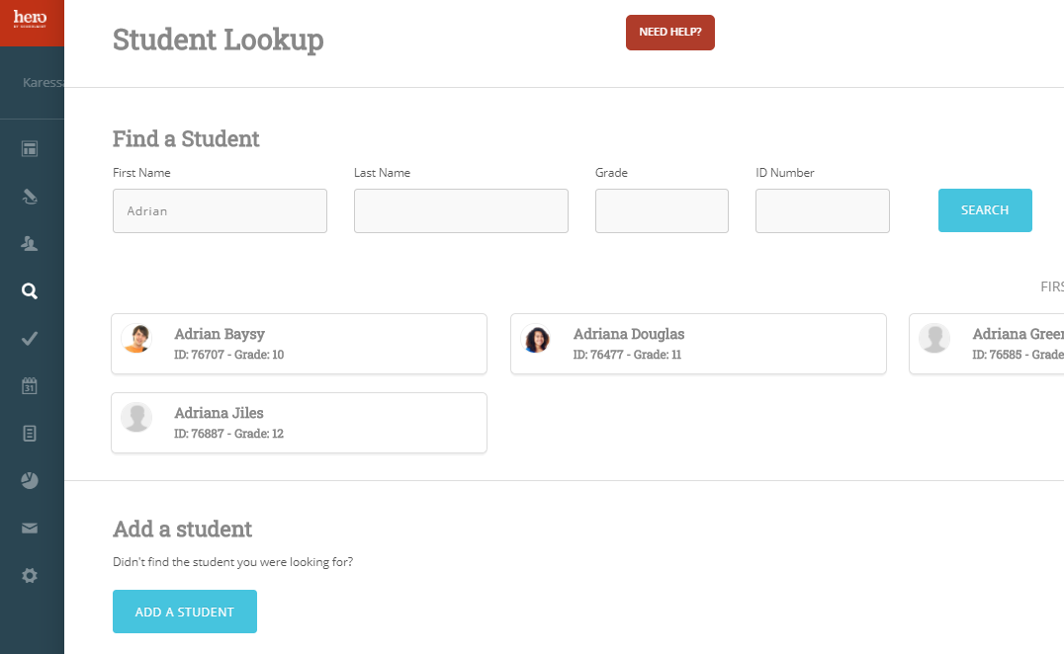
Search and select the student for whose account will be activated.
Notes:
Step 2: Search and select the student for whose account you will be activating.

Slide 5
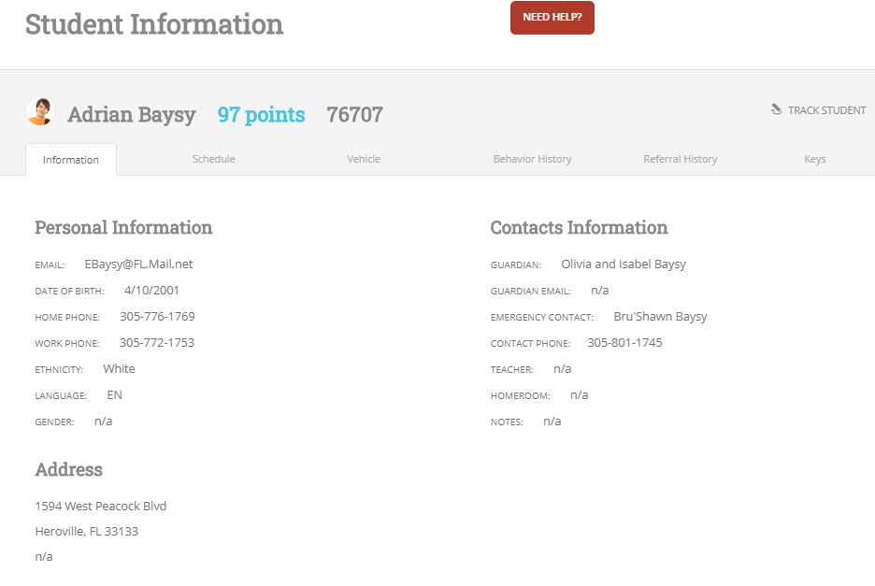
Confirm that the student has a student email address on file in Hero.
Notes:
Step 3: Confirm that the student’s email address is listed in Hero. QR Code activation only works if the student’s email address is already in Hero.

Slide 6
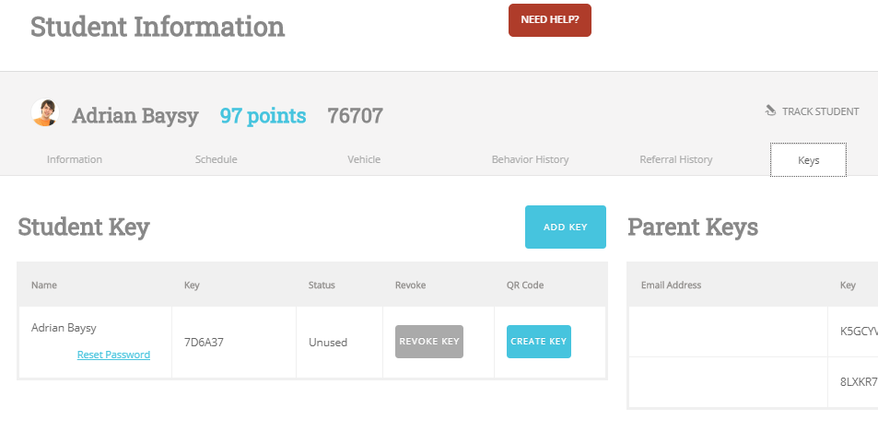
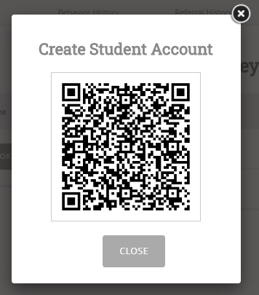
4
Select the KEYS tab.
Select CREATE KEY
to generate a QR Code.
Notes:
Step 4: Select the KEYS tab and then select “CREATE KEY” within the QR code column to generate a QR Code. Note that this QR code is unique to this student and will only be active for a short period of time to ensure that no other students try to activate someone else’s account.

Slide 7
5
Allow the student to scan the QR Code from their Hero mobile app and create their password.
Then CLOSE the QR Code and repeat steps for the next student.
Notes:
Step 5: Once the student has scanned the QR code and created their password, confirm that they see the correct information. Then, CLOSE the QR code and repeat the steps for the next student.

Slide 8
QR Code Activation – STUDENT INSTRUCTIONS
Notes:
Now we will review the steps for STUDENTS to activate their accounts using the QR code.

Slide 9
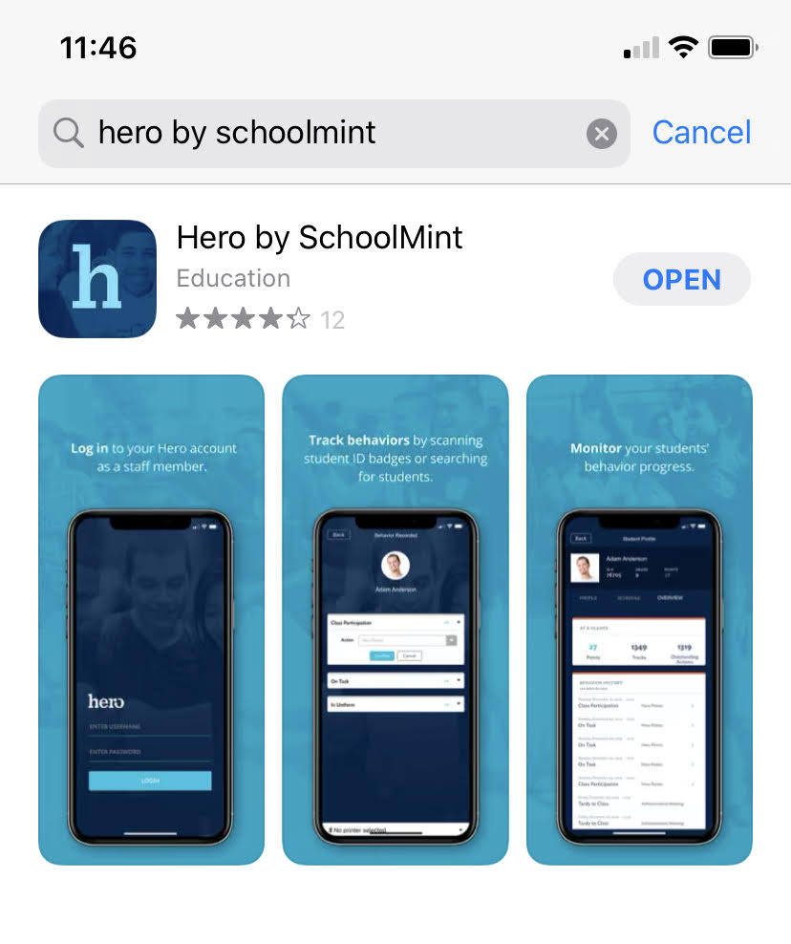
Download the Hero App on your mobile device!
Search “Hero by Schoolmint” in your App Store.
Notes:
Step 1: Dthe Hero mobile app on your personal mobile device! Search “Hero by Schoolmint” in your app store.

Slide 10
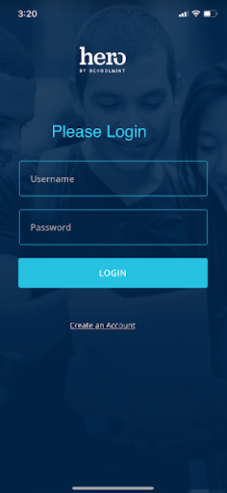
Select
“CREATE AN ACCOUNT”
Notes:
Step 2: Since we are creating a NEW account and have never logged in before, select “CREATE AN ACCOUNT.”

Slide 11
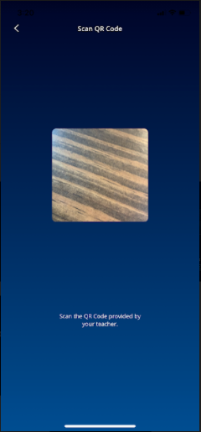
Use the camera on your
mobile device to scan the QR code on your teacher’s screen.
Each student receives their own unique QR code to scan.
Notes:
Step 3: Use the camera on your device to scan the QR code that your teacher has shared with you.

Slide 12
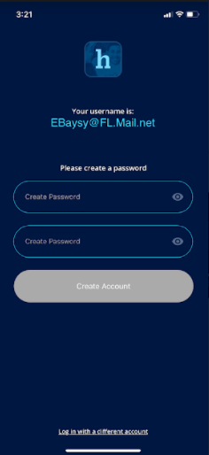
4
Enter a password you will use to log in each time.
Make sure you choose a password you will remember, or check with your teacher for further instructions.
Confirm your password.
Select
“CREATE ACCOUNT”
Notes:
Step 4: Enter a password that you can remember. You may need to check with your teacher if there’s a specific password they would like for you to use. Then, retype your password to confirm. Then select “Create User.”

Slide 13
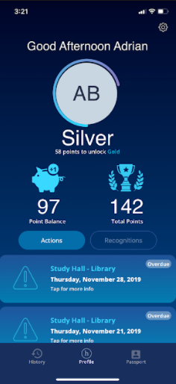
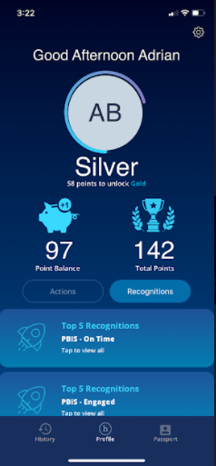
5
View your Hero information!
Confirm that the student information is correct.
Notes:
Step 5: You should now be able to view your Hero information in the mobile app. Confirm that the information is correct.

Slide 14
6
******
Logging Back In –
You can now log back in to the Hero mobile app at any time with your student email address and the password you created.
Notes:
Step 6: You may log back in at any time on the Hero mobile app by using your school email address and the password you just created.

Slide 15
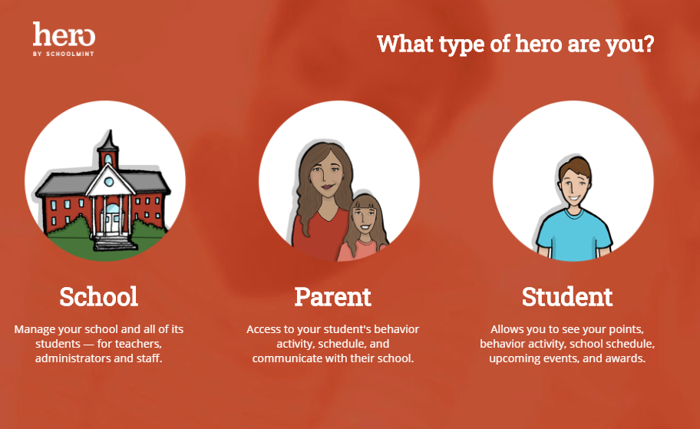
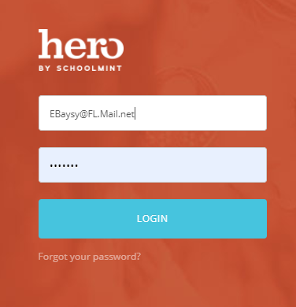
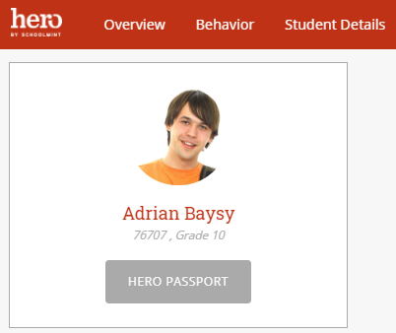
7
You can also log in to your Hero student information on the web with the same credentials.
https://access.heropowered.com
Select STUDENT
Notes:
Step 7: You can also access your Hero information on the web by visiting https://access.heropowered.com and selecting STUDENT. Type in your school email address and the password you just created to view your Hero information on the web.

Slide 16
If you were not able to successfully create your account, please contact your teacher or school’s Hero administrator.
?
Now that you’ve created an account, you can log back in any time on the web or mobile app.
NEED HELP?
If at any time you are not able to log in, please check that your username and password are typed correctly - wait and try again a few minutes later.
If you are still not successful, then reach out to your teacher or school’s Hero administrator for help.
Notes:
If you were not able to successfully create your account, please contact your teacher or school’s Hero administrator.
Now that you’ve created an account, you can log back in any time on the web or mobile app.
If at any time you are not able to log in, please wait and try again a few minutes later. If you are still not successful, then reach out to your teacher for help.

