Slide 1

Unique Keys
Notes:
Hi! Welcome to Hero! I’m going to walk you through the steps of creating your student Hero account!

Slide 2

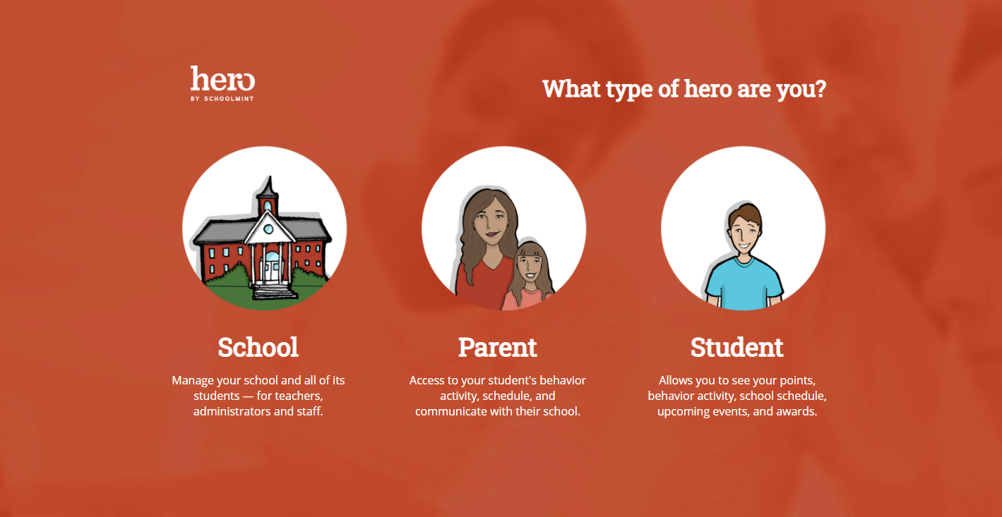
Visit
https://access.heropowered.com
Select “Student”
Notes:
Step 1: Visit https access.heropowered.com and select STUDENT

Slide 3

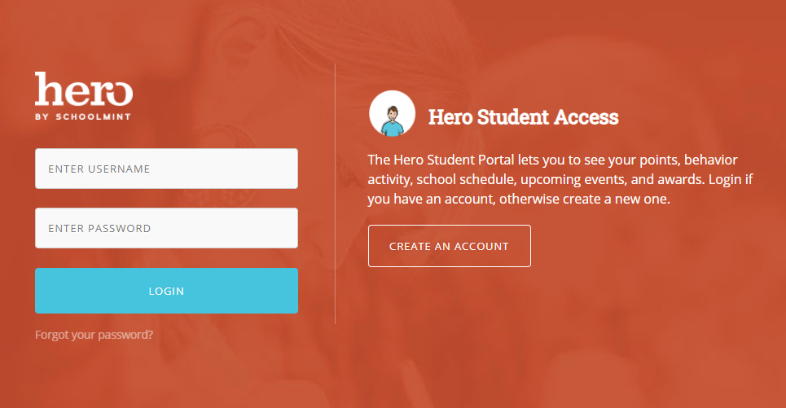
Select
“CREATE AN ACCOUNT”
Notes:
Step 2: Since we are creating a NEW account and have never logged in before, select “CREATE AN ACCOUNT.”

Slide 4

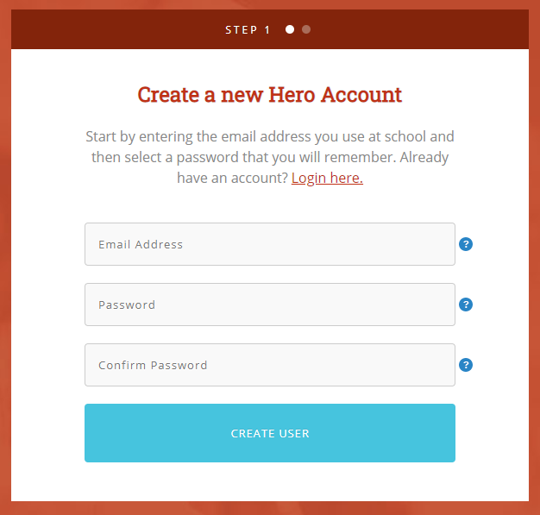

Enter an email address that will become your username.
We recommend using your school email address.
Be careful that your email address is typed correctly!
Check for
spelling errors!
Notes:
Step 3: Type in an email address that will become your username. We recommend that you use your school email address. It’s important that you check for spelling errors so that your username is not created with a mistake.

Slide 5

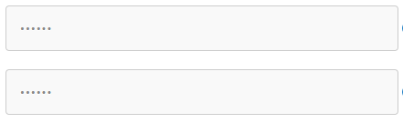
4
Enter a password you will use to log in each time.
Make sure you choose a password you will remember, or check with your teacher for further instructions.
Confirm your password.
Select
“CREATE USER”
Make sure the passwords match and it’s a password you can remember!
Notes:
Step 4: Enter a password that you can remember. You may need to check with your teacher if there’s a specific password they would like for you to use. Then, retype your password to confirm. Then select “Create User.”

Slide 6
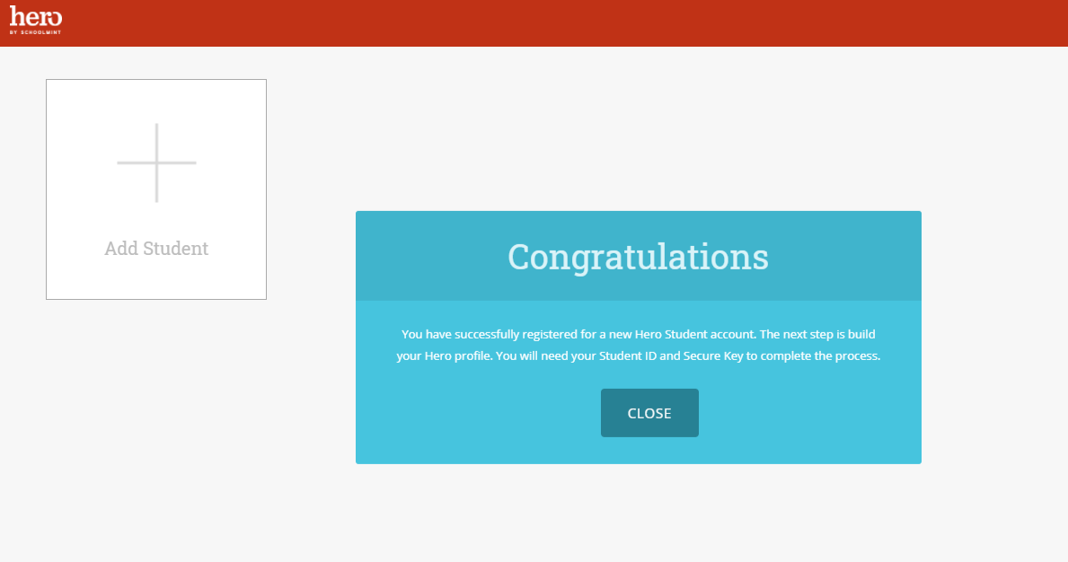
5
VERY IMPORTANT!!
“Close” the Congratulations Message.
Select
“Add Student”
Notes:
Step 5: IS CRITICAL! You have CREATED your account, but now it is very important to link your student profile. Close the congratulations box and select “ADD STUDENT”.

Slide 7
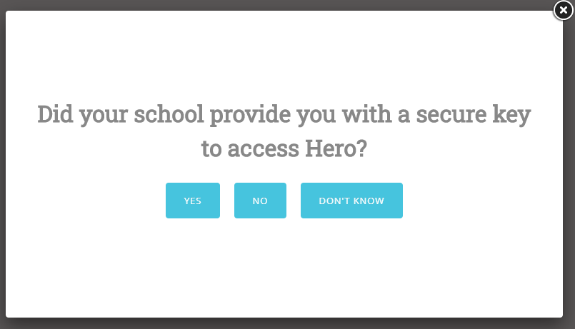
6
Because you will be using a Unique Key that was provided to you by the teacher or school...
Select
“YES”
Notes:
Step 6: Since we are using a unique key that was provided by the school, select YES.

Slide 8
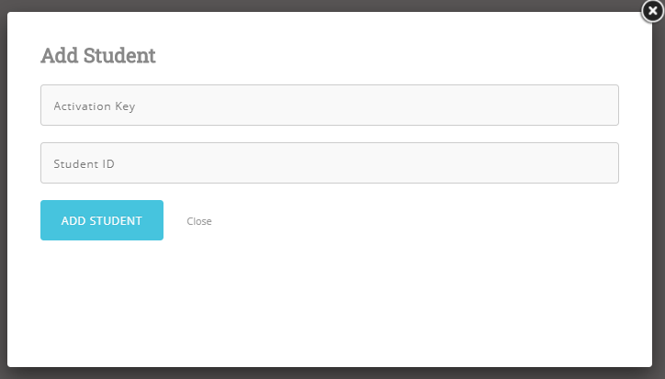
7
Type in the unique activation key provided by your school.
Each key contains six characters of letters and/or numbers.
Notes:
Step 7: Type in the unique activation code provided by your school. The code should be a six-character code made up of numbers and letters.

Slide 9
8
Type in your student ID number.
Select
ADD STUDENT.
Notes:
Step 8: Type in your student ID number. Then select ADD STUDENT.

Slide 10
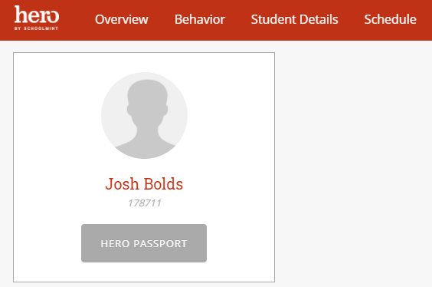
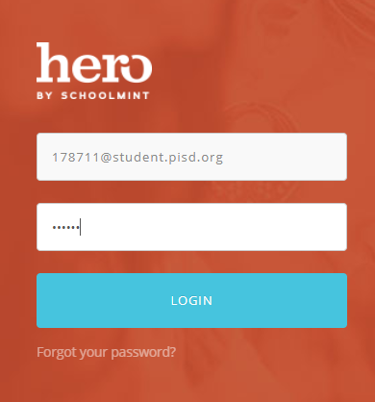
9
Access Your Hero Information!
It’s possible that the system will log out automatically and force you to log back in with your newly created credentials!
Notes:
Step 10: You should now be able to view your Hero information from the web! It’s possible that the system will log you out automatically and force you to log back in using your newly created credentials.

Slide 11
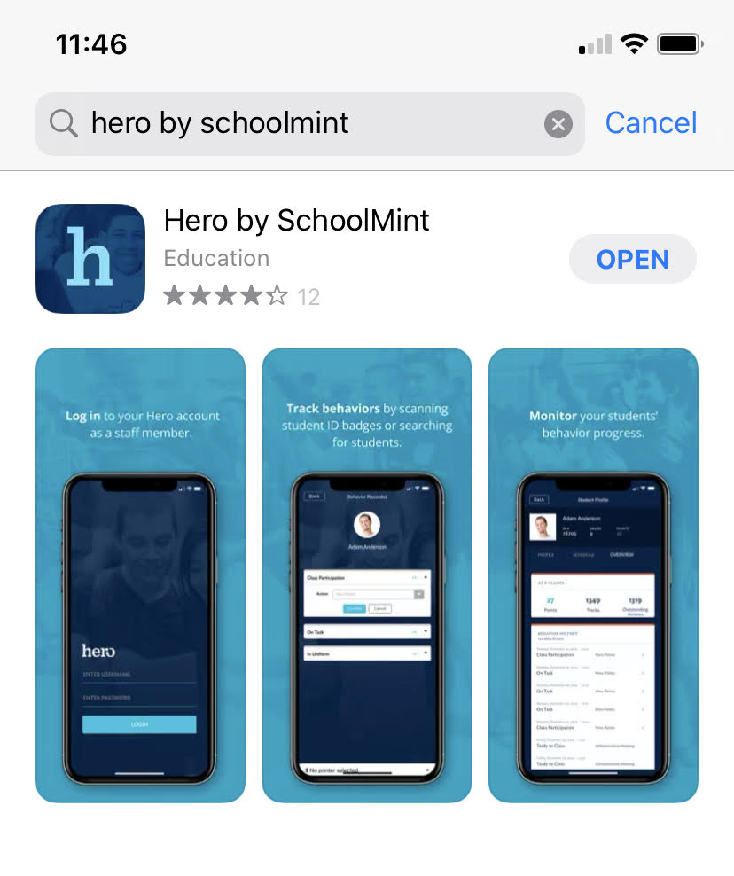
10
Download the Hero App on your mobile device!
Search “Hero by Schoolmint” in your App Store.
Notes:
Step 11: You can now also download the Hero mobile app on your personal mobile device! Search “Hero by Schoolmint” in your app store.

Slide 12
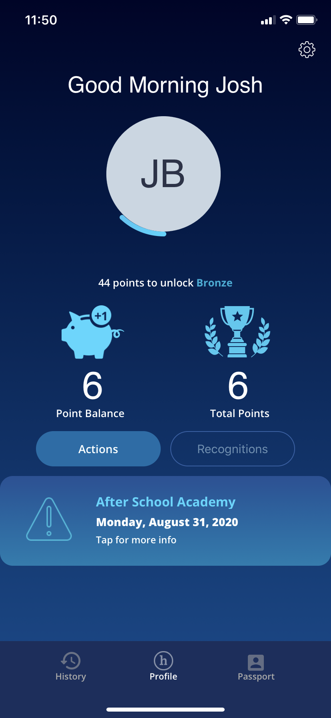
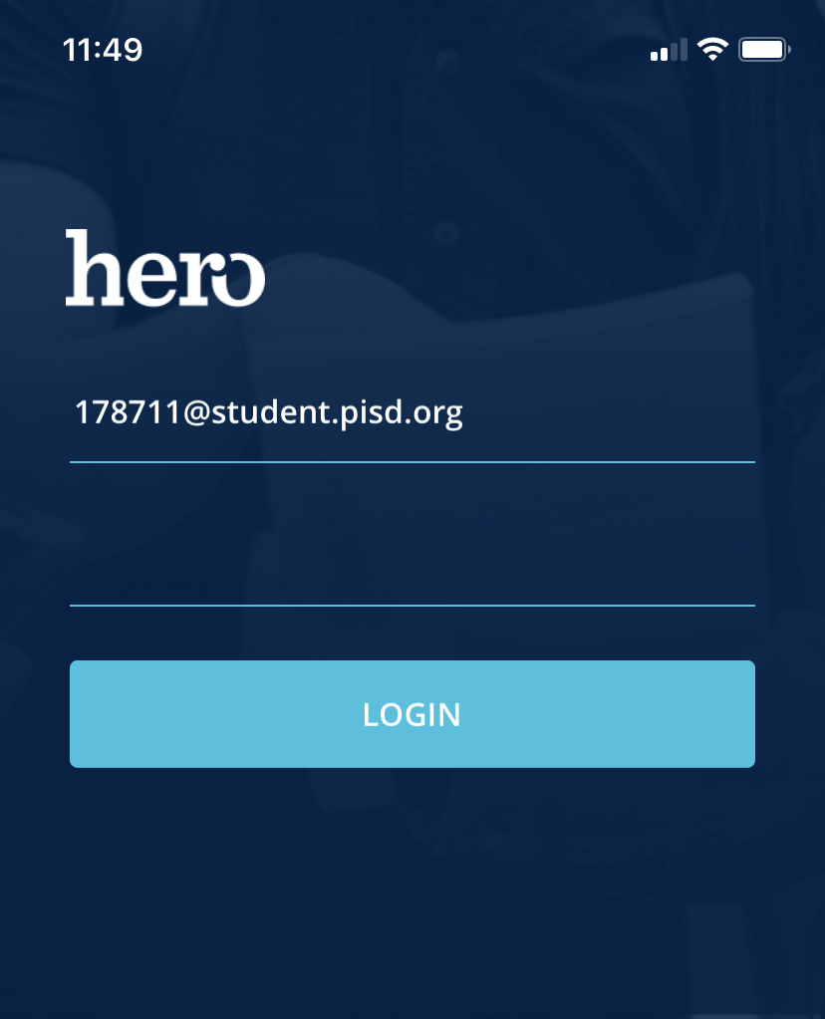
11
Log in to the Hero app with your newly created credentials.
View your Hero information!
Notes:
Step 12: Log in to the mobile app with the credentials you created in steps 2-4. You can now view your Hero information from your mobile device!

Slide 13
If you were not able to successfully create your account, please contact your teacher or school’s Hero administrator.
?
Now that you’ve created an account, you can log back in any time on the web or mobile app.
NEED HELP?
If at any time you are not able to log in, please check that your username and password are typed correctly - wait and try again a few minutes later.
If you are still not successful, then reach out to your teacher or school’s Hero administrator for help.
Notes:
If you were not able to successfully create your account, please contact your teacher or school’s Hero administrator.
Now that you’ve created an account, you can log back in any time on the web or mobile app.
If at any time you are not able to log in, please wait and try again a few minutes later. If you are still not successful, then reach out to your teacher for help.

